Slide 1
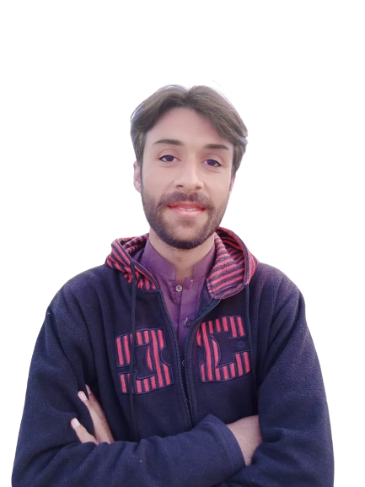
Complex Task Series
Problem Number 32

Slide 2
Problem Statement
Write a Web Application to register a user on Django.

Slide 3
Algorithm
Step1: Install Python Django Library
Step2: Create Project
Step3: Create Application And Include In Settings.Py File In Django Project
Step4: Create Template Directory In Application
Step5: Create Register HTML File In Application Template
Step6: Write view for Register HTML file in views.py
Step7: Create form for User Registration
Step8: Write URL for Home view in urls.py
Step9: Display the result in Browser
END

Slide 4
Assignment
Write a Web Application to add login functionality in Django Application.

